Slide 1
Working with GDI+ Crystal Reports & Printing

Slide 2
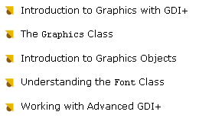
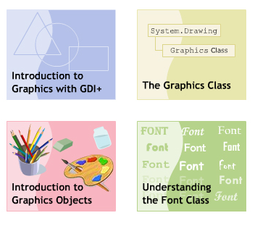

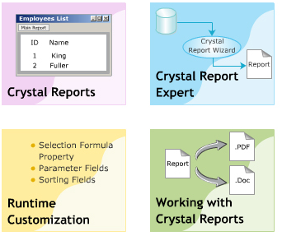

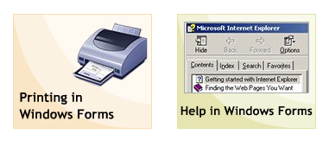
Objectives

Slide 3
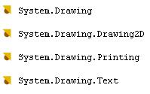
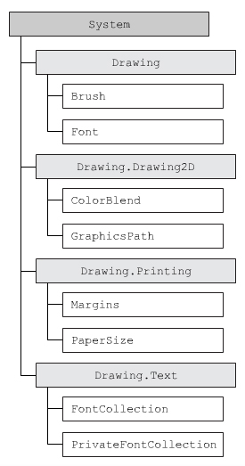
GDI+ class
Create and render Graphic
Display information on the computer screen, printer

Slide 4

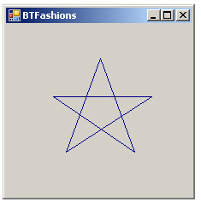
Device Context – Graphics Objects
Device Context is a DataStructure that contains information about different graphic objects
Pen, Brush …
Draws Image, Graphics on any device
Graphics Objects : Pen ( draw lines ) , Brush …

Slide 5
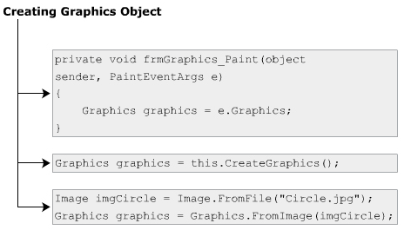
Graphics Object
To Draw various object on any device

Slide 6

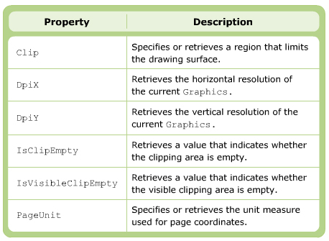
Graphics Object

Slide 7

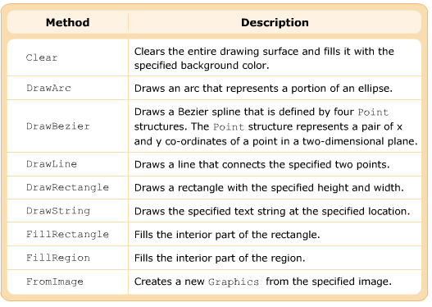
Method
Steps :
Get Graphics Object
Make a Pen object
Call DrawXXX method

Slide 8
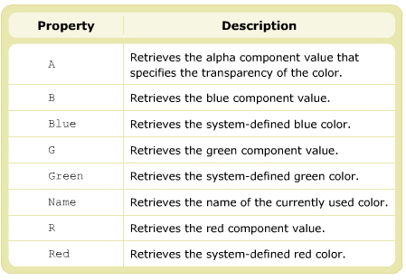
Color structure
Provided by the GDI+ to provide various Color
This structure defines the alpha , red , green , blue value , which are the four primary components of the structure
Alpha component → increase the transparency of the color.

Slide 9

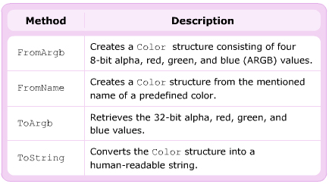
Color - Method

Slide 10
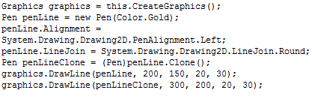
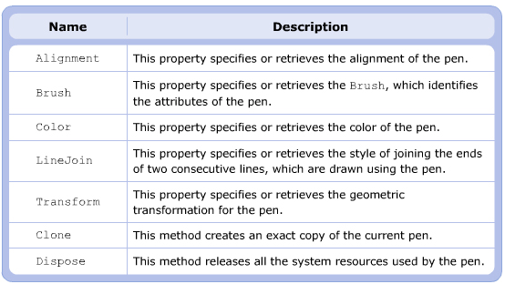
Pen class

Slide 11
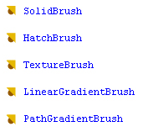
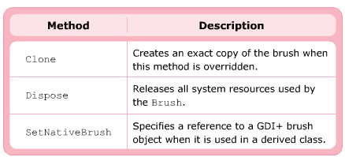
Brush class
Graphical shapes can be filled with color by using the Brush class
This is a abstract class – therefore you can use its derived classes bellow :

Slide 12
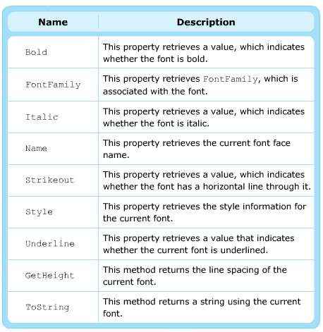
Font class
Provide the font face,size and style attributes to format text (System.Drawing namespace)
GDI fonts : ( in folder Fonts of system- “Arial”)
Device fonts are used for output devices such as monitors or printers

Slide 13

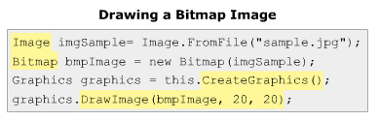
Display Image

Slide 14
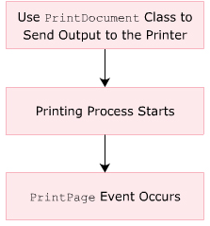
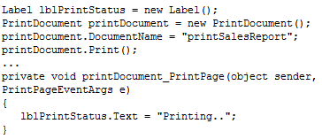
Printing GDI+ Object
Using PrintDocument class to print data and Image

Slide 15
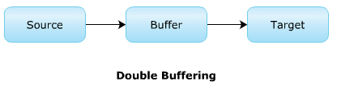
Double Buffering
One of the most problem with a complex image ( complex combination of shapes, text …) is that they flicker.
Another reason for flickering is the frequent redrawing of images on the control
To overcome the problem , .NET provide the Double Buffering technique – all the drawing operations is first performed in a buffer memory. Then , from the buffer, the image is drawn on the target screen.

Slide 16
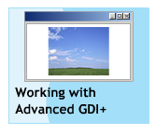

How to
To implement DoubleBuffering technique, you can set the DoubleBufferred property of the Control class to TRUE
Alternatively , you can also invoke the SetStyle() methol of the Control class to set the OptimizedDoubleBuffer value to TRUE.

Slide 17
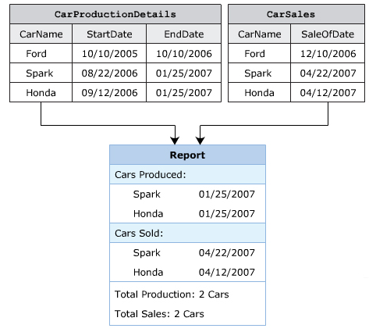
Crystal Report

Slide 18
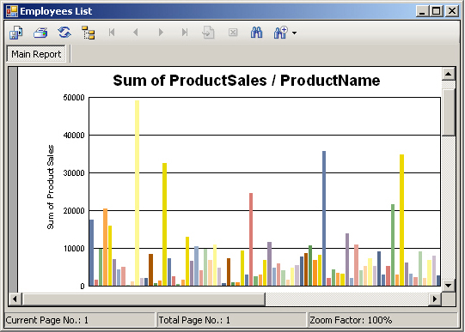
Advantages of Crystal Report
Simplifies the process of analyzing data by generation of graphs.
Accelerates the process of computing complex calculation.
Displays data easily based on the search criteria.
Displays data easily using various charts and graphs.
Format Data easily.

Slide 19
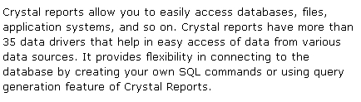


Features of Crystal Report

Slide 20

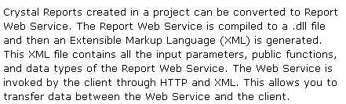


Features of Crystal Report

Slide 21
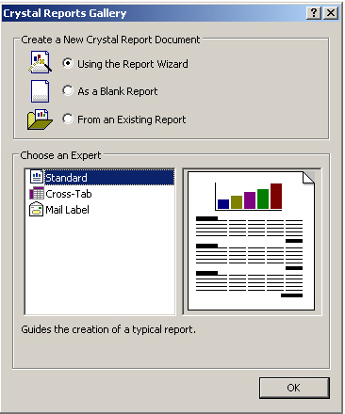
Crystal Report Creation Wizard
Guide you to choose a data source and link to the tables
It also guides you to sum up the totals, sort data, create charts and select records
Standard
Cross-Tab
Mail Label
- Mailing Labels Report Creation Wizard guides you to create a report that prints on a mailing label.

Slide 22
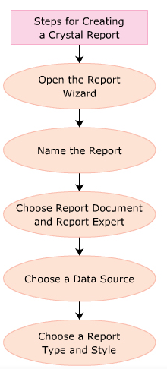

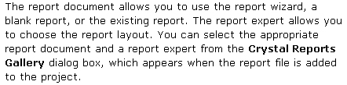


Step to create

Slide 23
Create Crystal Report using ADO.Net
CrystalReportViewer cvrEmployee = new CrystalReportViewer();
SqlDataAdapter sqlda = new SqlDataAdapter(“Select * from Employees” , con);
ReportDocument rdReport = new ReportDocument();
rdReport.Load(“D:/Employee.rpt”);
DataSet ds = new DataSet();
sqlda.Fill(ds , “Employees”);
rdReport.SetDataSource(ds);
cvrEmployee.ReportSource = rdReport;

Slide 24
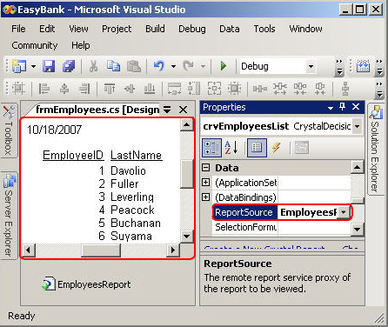
Binding Report – Passing Params
Binding report to the application by using CrystalReportViewer control.
Passing a parameter on a database field allows the user to specify values for that field to filter the records.

Slide 25
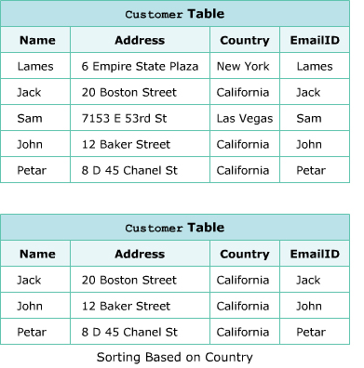
Sorting filed at runtime
CrystalReportViewer cvrEmployee = new CrystalReportViewer();
SqlDataAdapter sqlda = new SqlDataAdapter(“Select * from Employees” , con);
ReportDocument rdReport = new ReportDocument();
rdReport.Load(“D:/Employee.rpt”);
DataSet ds = new DataSet();
sqlda.Fill(ds , “Employees”);
rdReport.SetDataSource(ds);
cvrEmployee.ReportSource = rdReport;
FieldDefinition fdCountry = rdReport.Database.Tables[0].Fields[“Country”];
rdReport.DataDefinition.SortFields[0].Field = fdCountry;
rdReport.DataDefinition.SortFields[0].SortDirection = CrystalDecisions.Shared.SortDirection.DescendingOrder;

Slide 26


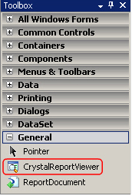
Report Viewer control

Slide 27

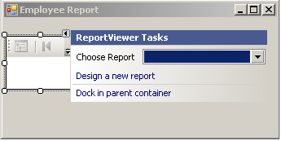
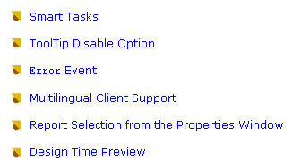
Binding Report

Slide 28
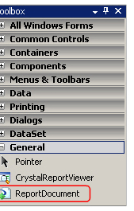
ReportDocument object model
Is a powerfull and flexible model to handle the report at runtime.
It provides many built-in class in different namespaces that are use to create , update and save report at runtime.
One of the most important class in this model is the ReportDocument class.
This class exits in the CrystalDecisions.CrystalReport.Engine namespace

Slide 29
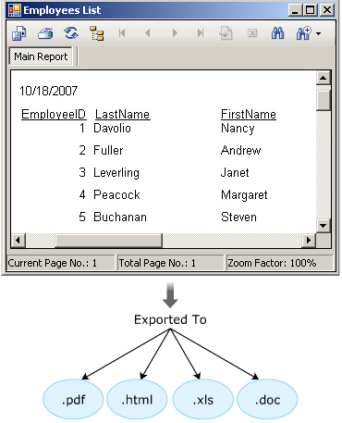
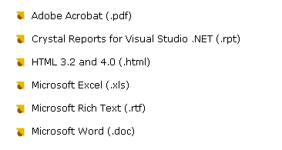
Purpose and Format

Slide 30
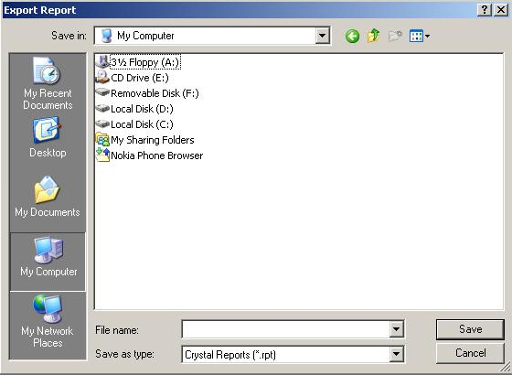
Exporting a Report
Using the Export button on the toolbar of CrystalReportViewer Control
Using the ExportReport() method of CrystalReportViewer class. This method invokes the Export Report DialogBox as bellow :

Slide 31
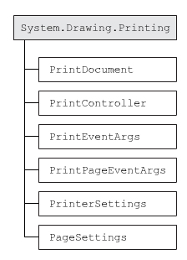
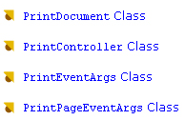
Printing

Slide 32
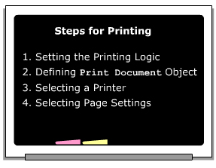
Step to Print
Must have PrintDocument object
Invoke the Print() method
This will raise PrintPage event which takes an object PrintPageEventArgs
Pages Setting by PageSetupDialog

Slide 33
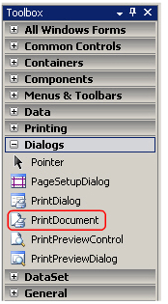
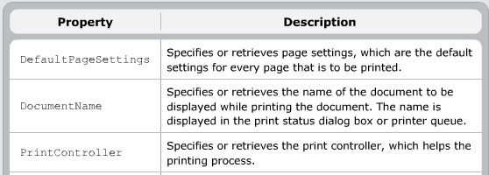
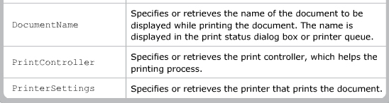
PrintDocument
Provides ability to print documents : .txt , .pdf …
Two main purpose :
Single print job
Complex print job

Slide 34
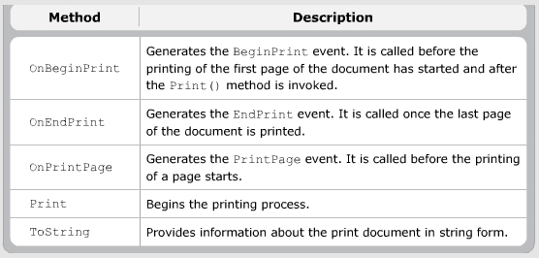
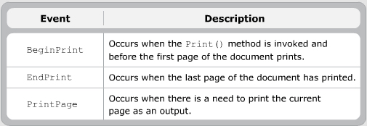
Method - Event

Slide 35
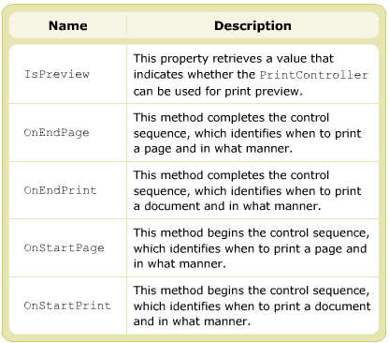
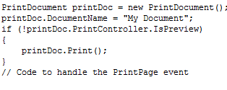
PrintController class
Regulates printing process of PrinDocument
This class is abstract
Derived class : StandardPrintController , PreviewPrintController, PrintControllerWithStatusDialog

Slide 36
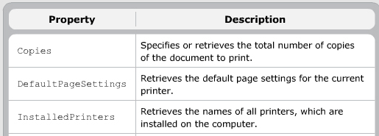
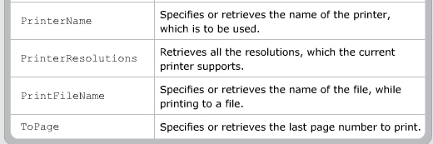

PrinterSettings class
Specifies how a document is printed, including the printer
You can access this class by PrintDocument.PrinterSettings or PageSettings.PrinterSettings

Slide 37




Dialog Boxes and Component Controls

Slide 38




Help in Application
Help class : used to display content of .chm file

Slide 39


ShowHelp() method - Software
This method takes 3 parameters : control , “.chm” , and element need display
Some option : HelpNavigator.Index , HelpNavigator.TableOfContents
There are many software to create .chm file … But HTML Help WorkShop is the software to be provided by Microsoft
It helps to create .hhp file(help system) - .hhc (Table of Contents) and Index (.hhk) files.

Slide 40



Type of Help- Step to create .chm

Slide 41




HelpProvider Component
Link the help file to Application – Press F1 on control will invoke help file
HelpProvider hp = new HelpProvider();
hp.HelpNamespace = “C:/demo.chm”;
hp.SetShowHelp(txtName , true);

Slide 42



HelpButton property - Form

Slide 43




ToolTip

Slide 44


Method and Event

